Slide 1

Importance of Soil Testing
Gabrielle de Souza
Soil Scientist

Slide 2
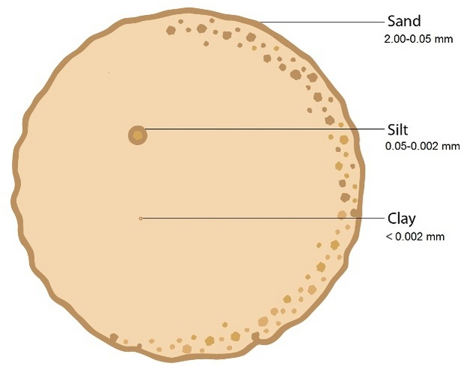
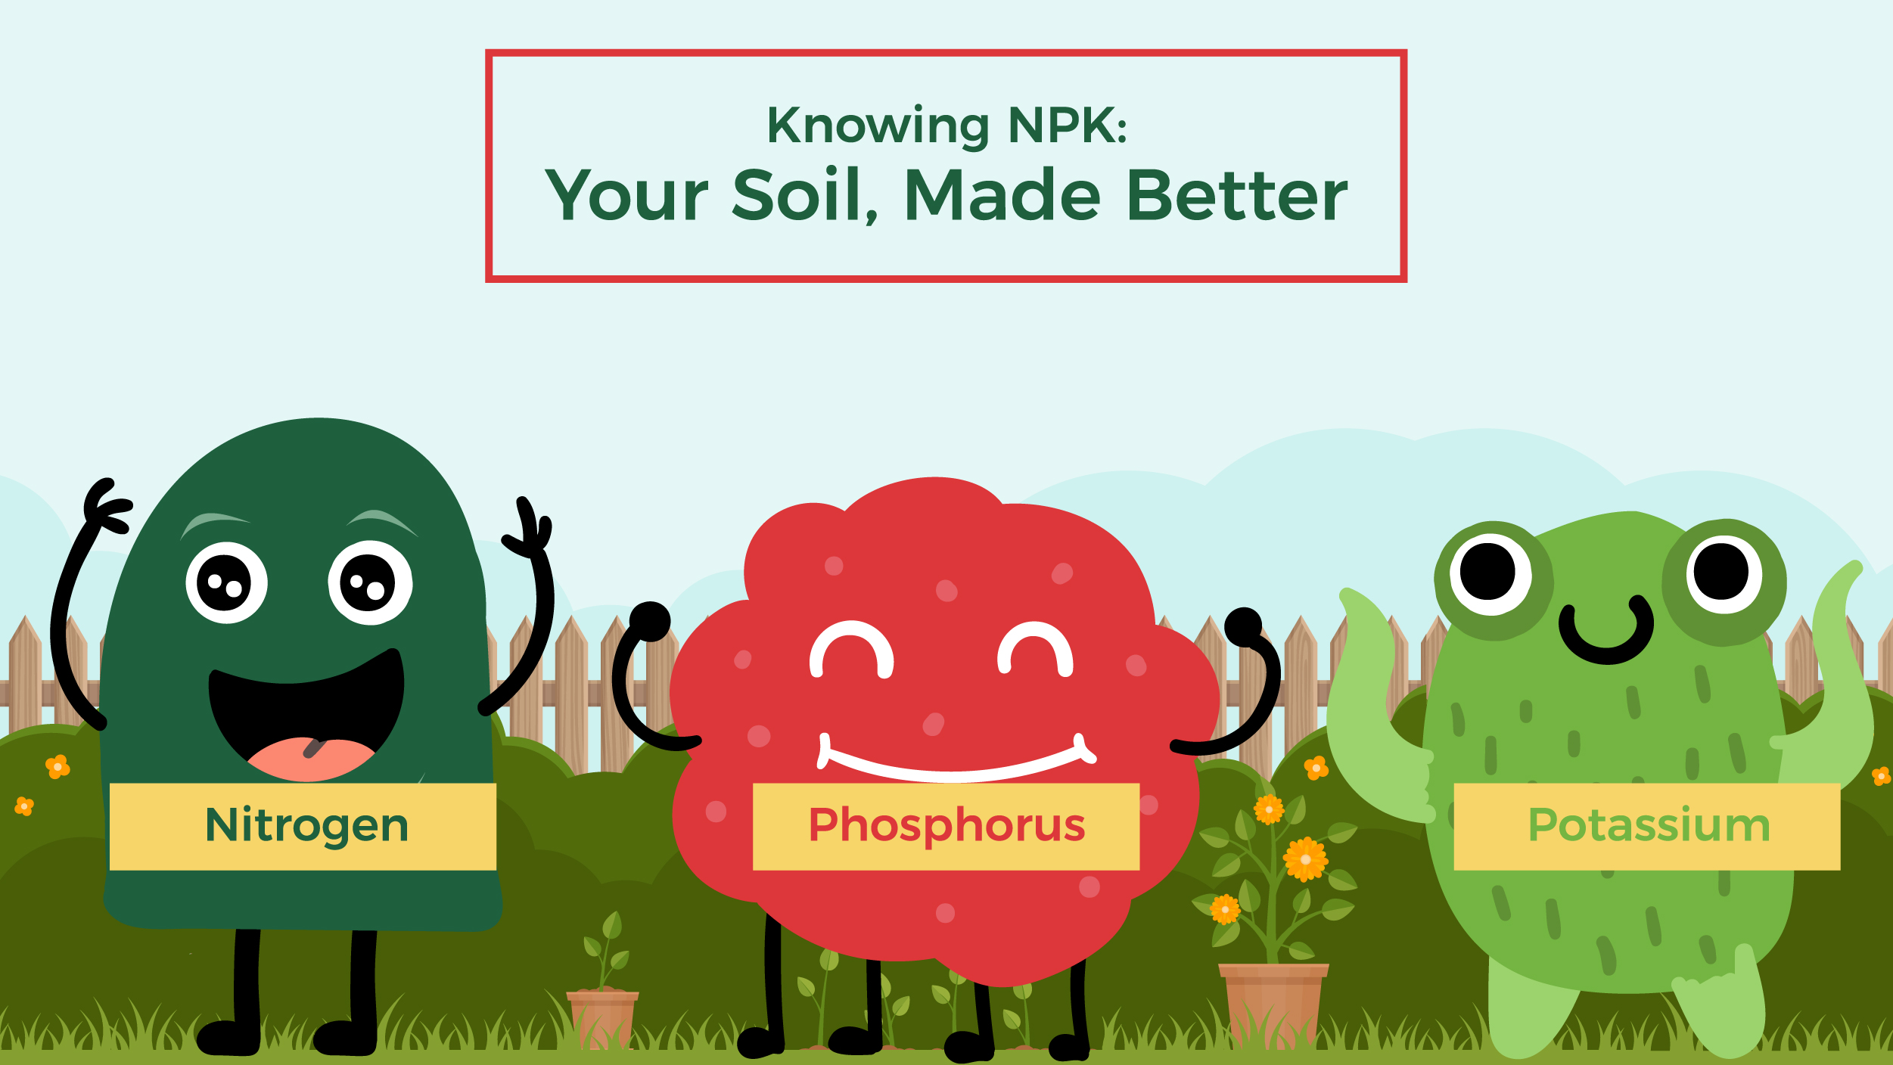
Importance
of
Soil Testing

Slide 3
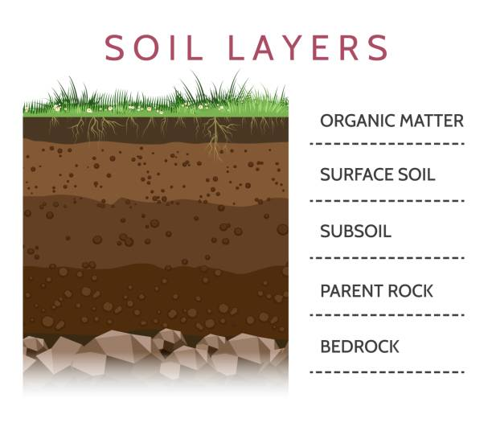
What is soil?
Soil is a material composed of four components — minerals, organic matter, air, and water.

Slide 4
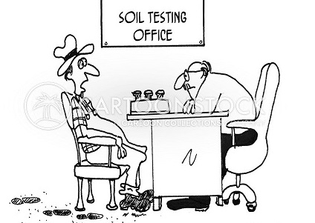
What is a soil test?
A soil test is a test which can determine the current fertility and health of your soil.
It is used to determine the pH and fertility level. This is the first step in planning a sound nutrient management program.

Slide 5
Reasons for Soil Testing
A soil test is important for several reasons:
  To optimize crop production,
  To protect the environment from the misuse of agricultural inputs
  To aid in the diagnosis of plant problems,
  To save money and conserve energy by applying only the amount of fertilizer needed.
  To serve as a guideline for land use and management.

Slide 6
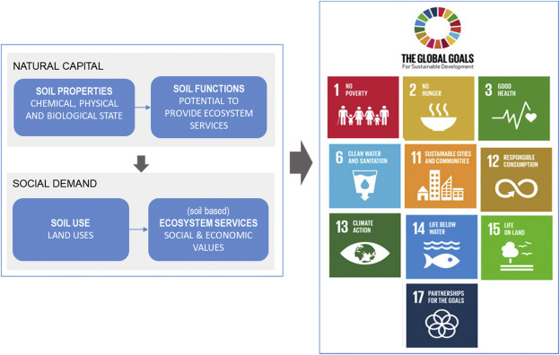
Source: Erdogan et al. (2021)

Slide 7
Good Management Practices for Soil
Healthy Soil
Land Preparation
Water Use
Crop and Seed Selection
Agricultural Inputs

Slide 8
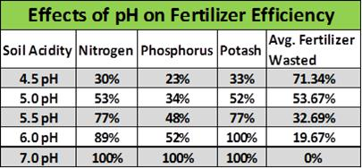
Source: Baker Lime (RHI Magnesita), 2021

Slide 9

Components of Soil Testing

Slide 10
How do you take a soil sample?
Before taking a soil sample, it is important to use clean materials and equipment.
Select a spot (15 x 15cm), free from plants, leaf litter and mulch.
Use soil auger/ spade/ shovel and dig to soil depth of 0-15cm (30cm)
Place soil sample in labelled sample bag
Send sample to laboratory for analysis

Slide 11
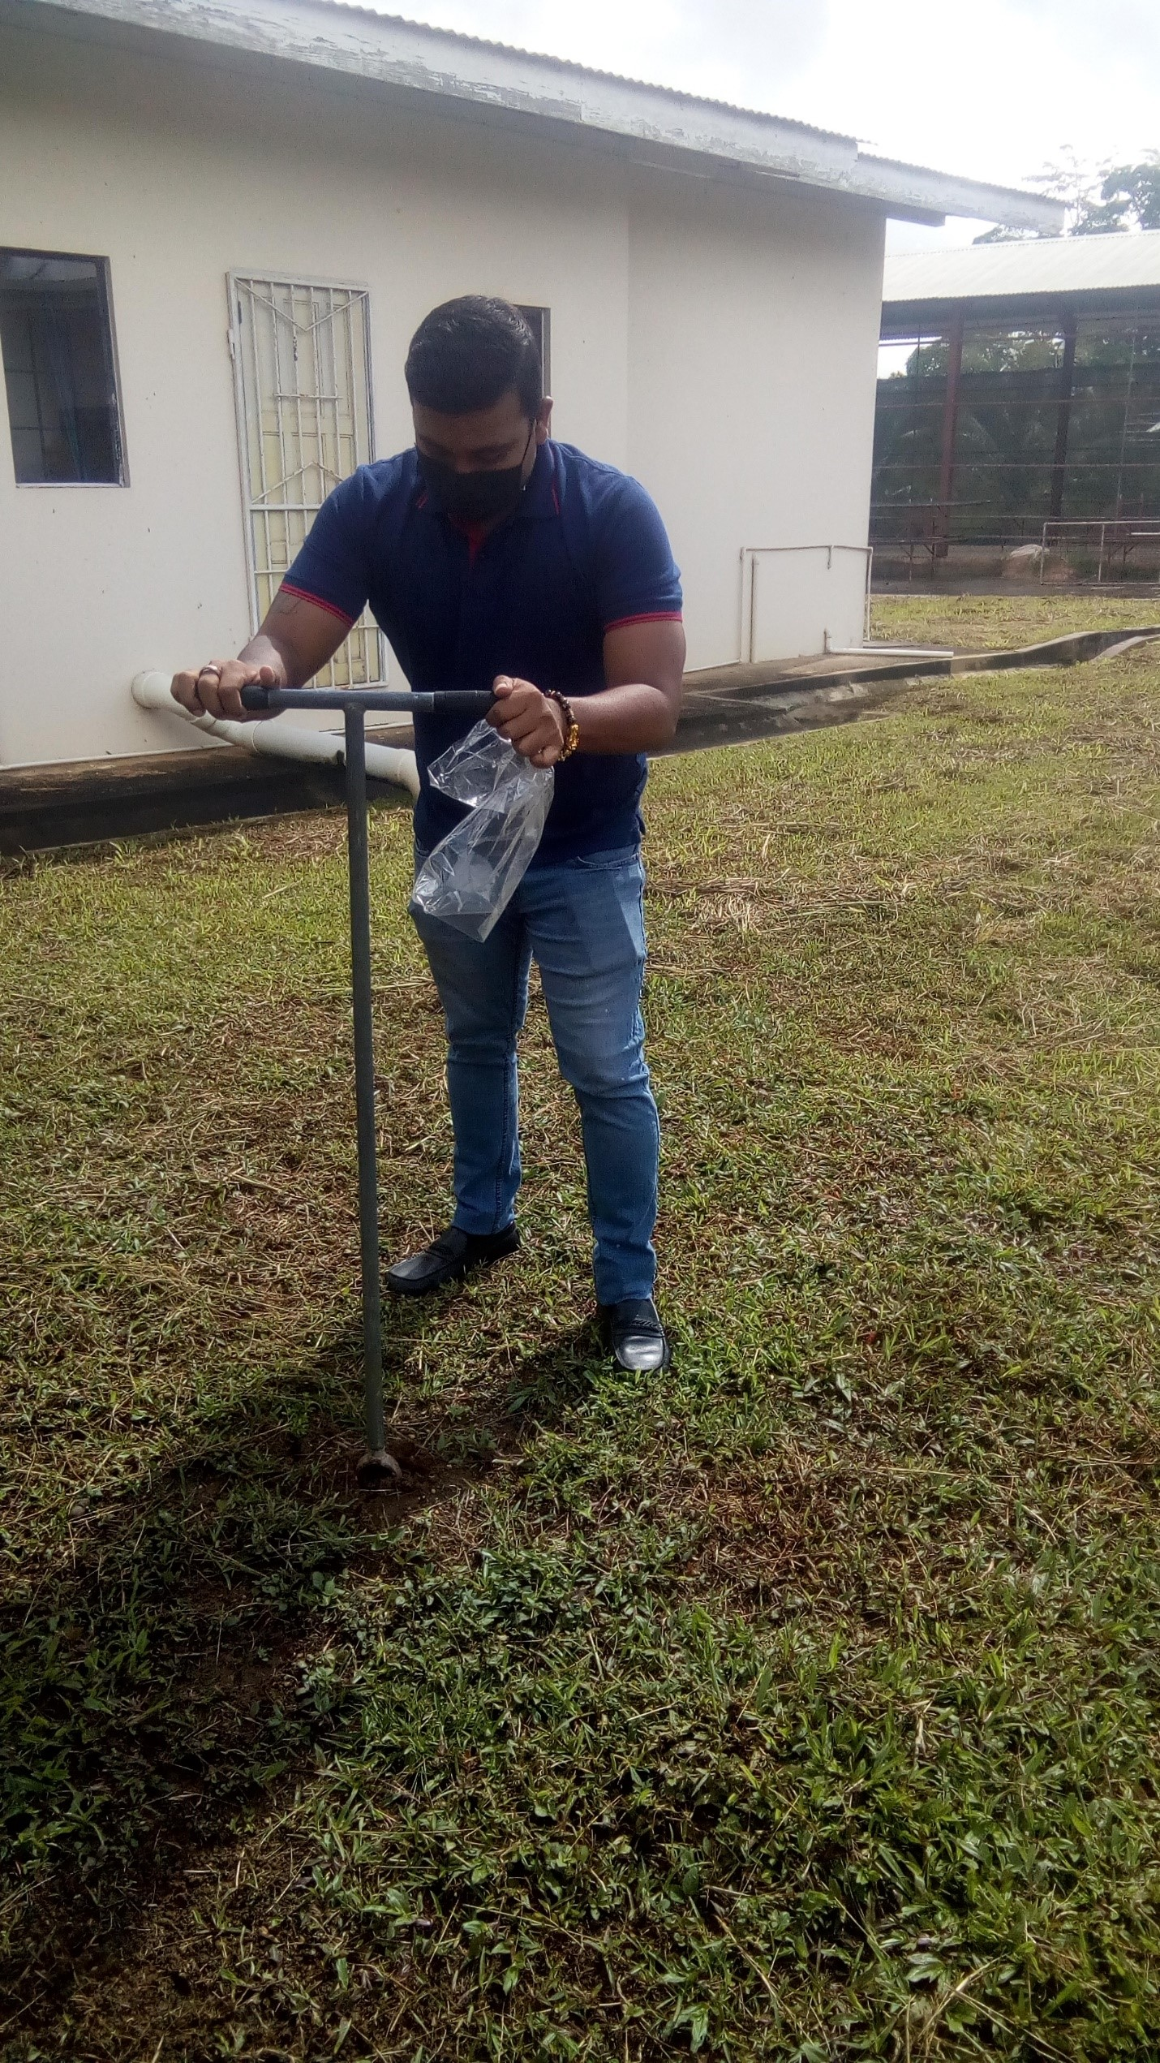
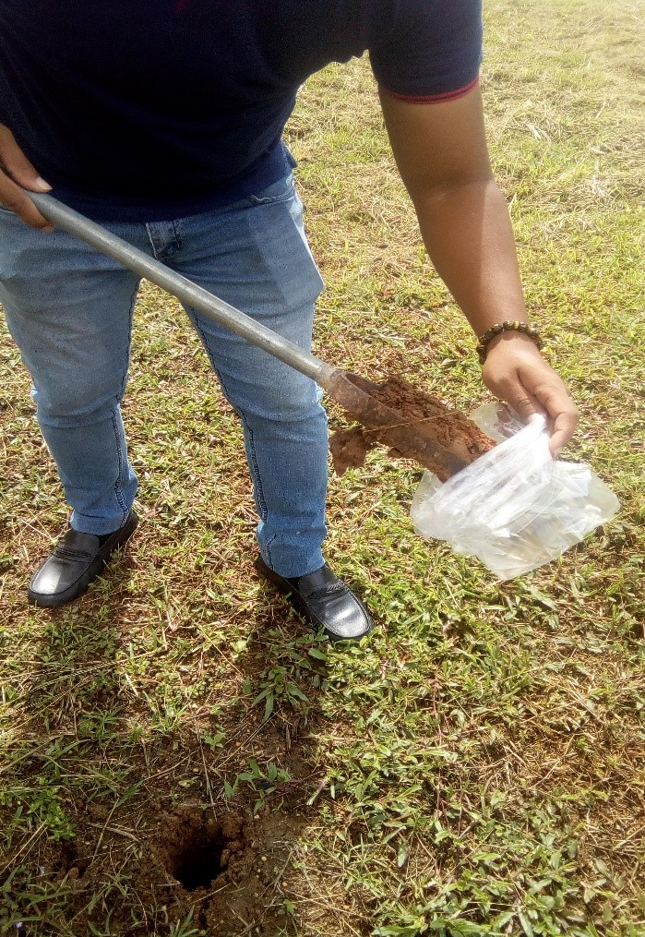
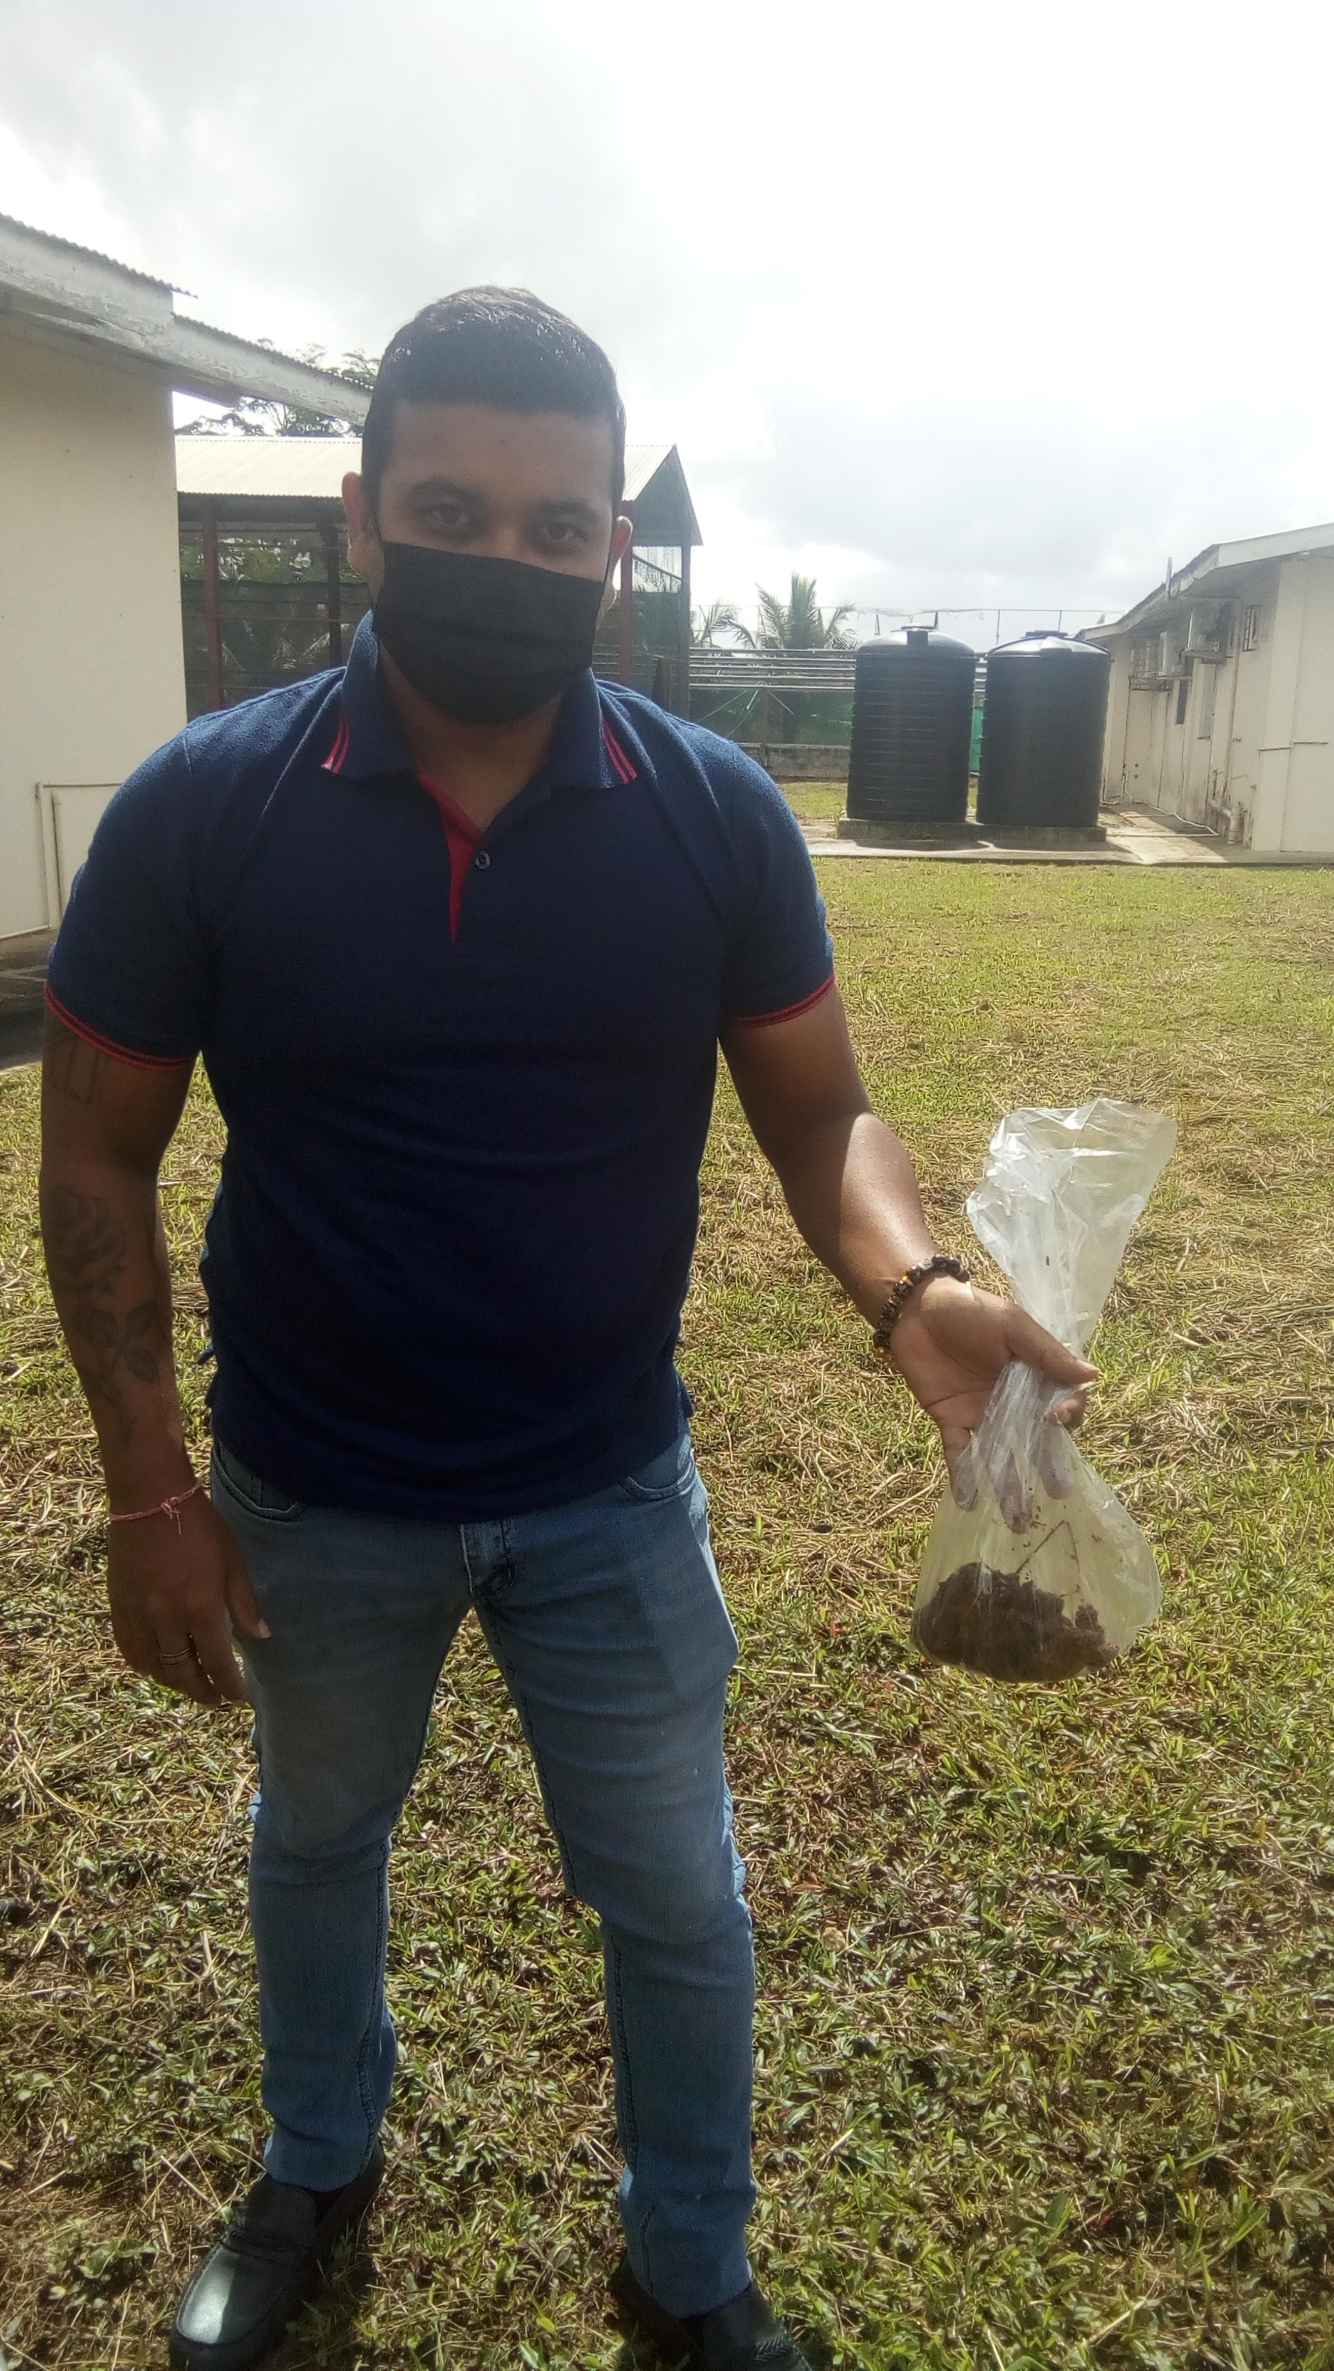
Taking a soil sample
Shivan Gajadhar, Agricultural Assistant I

Slide 12
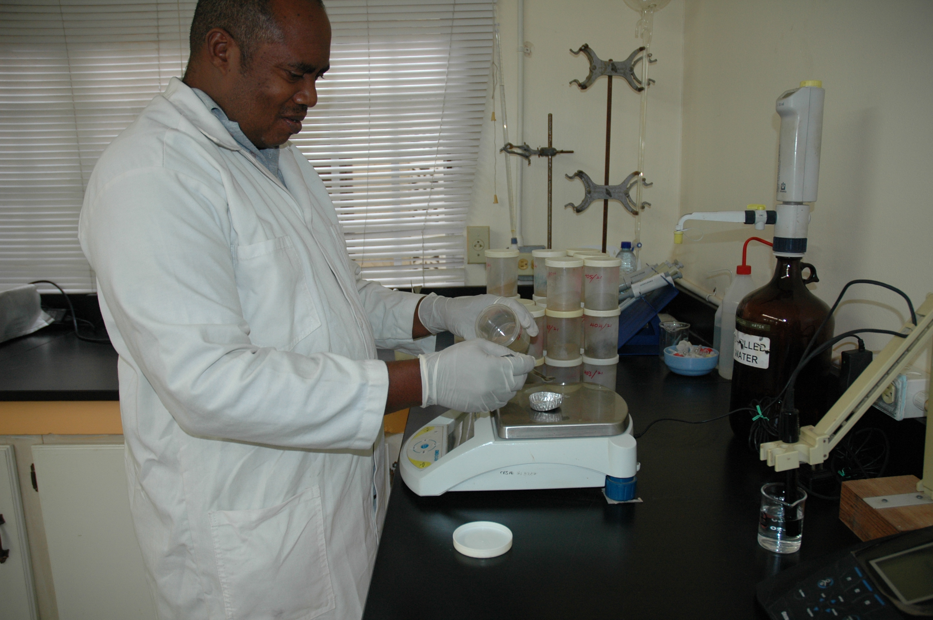
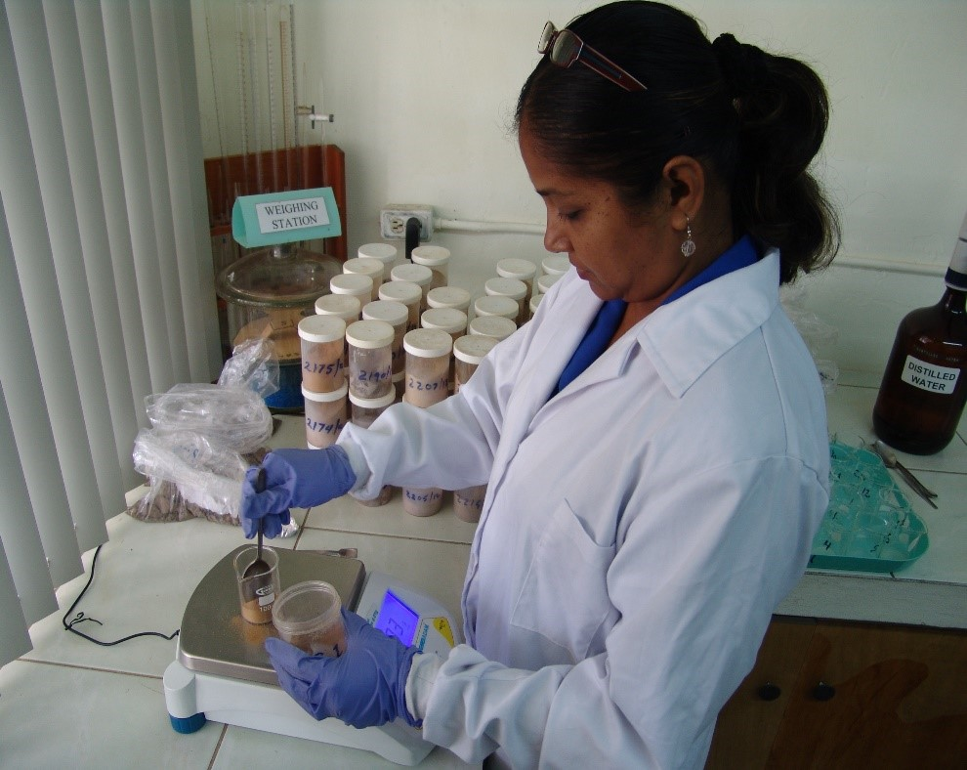
Weighing soil for analyses
Ronald Cox, Soil Research Technician
Shanti Ramgoolam, Laboratory Assistant

Slide 13
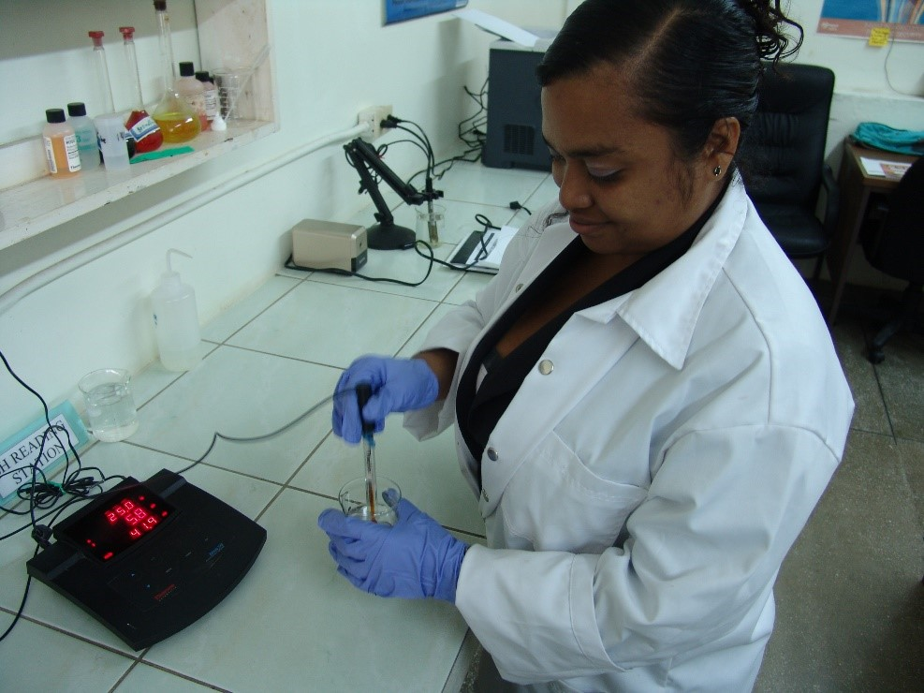
pH Analysis
Gabrielle de Souza, Soil Scientist

Slide 14
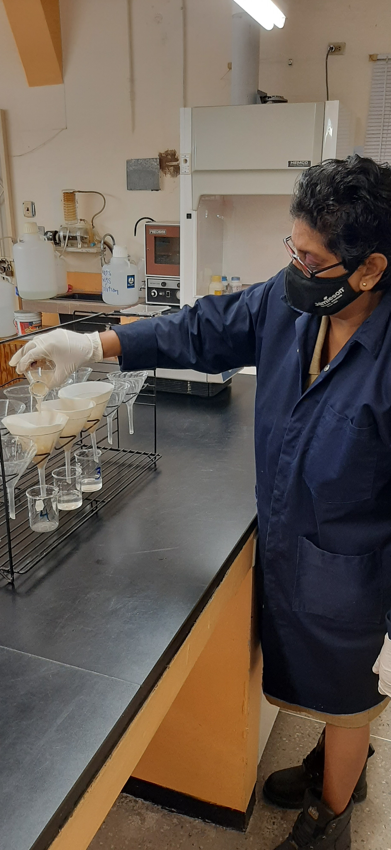
Filtering substrate for analysis
Sherry Small, Soil Research Technician

Slide 15
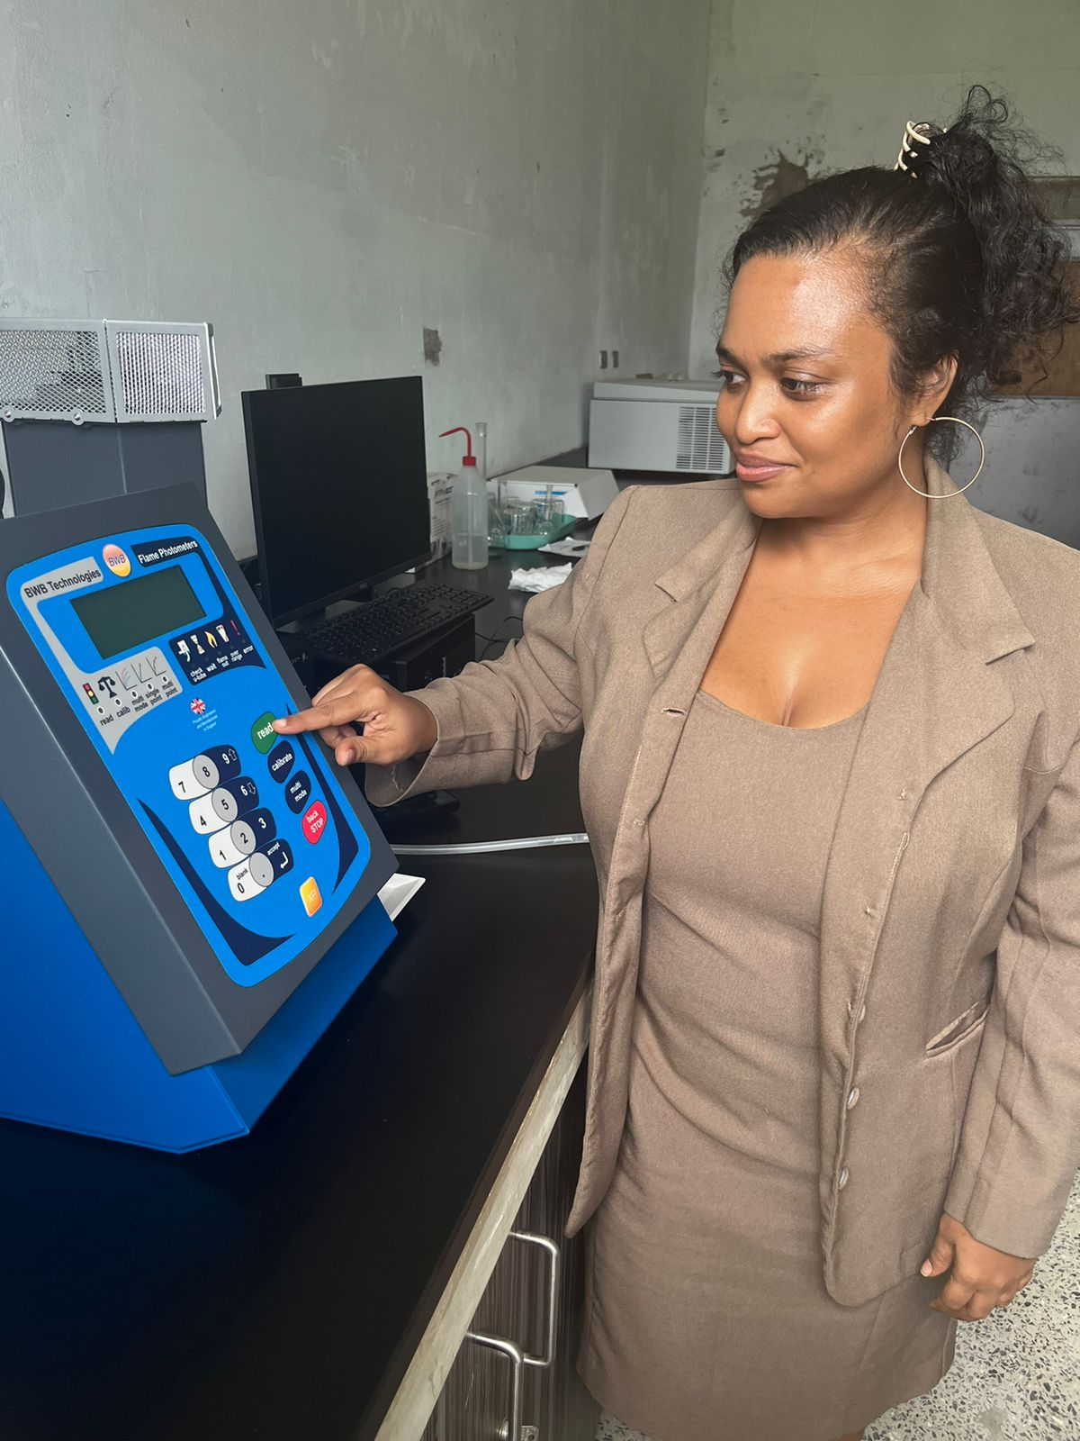
Analyses on the Flame Photometer
Gabrielle de Souza, Soil Scientist

Slide 16
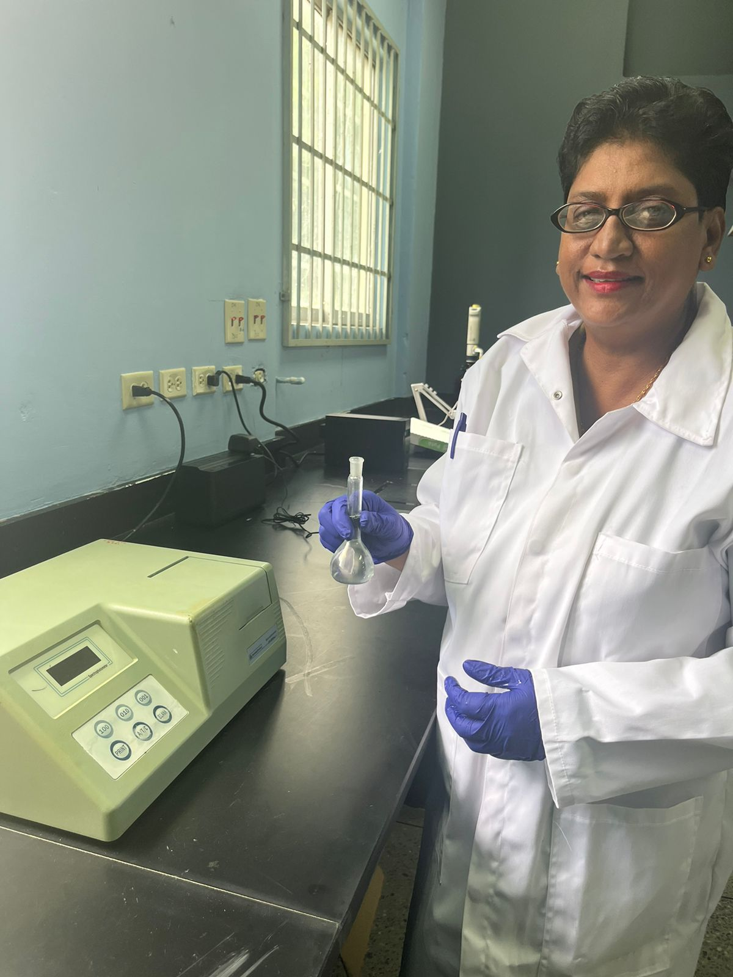
Phosphorus analysis using uv-vis spectrophotometer
Sherry Small, Soil Research Technician

Slide 17


Slide 18
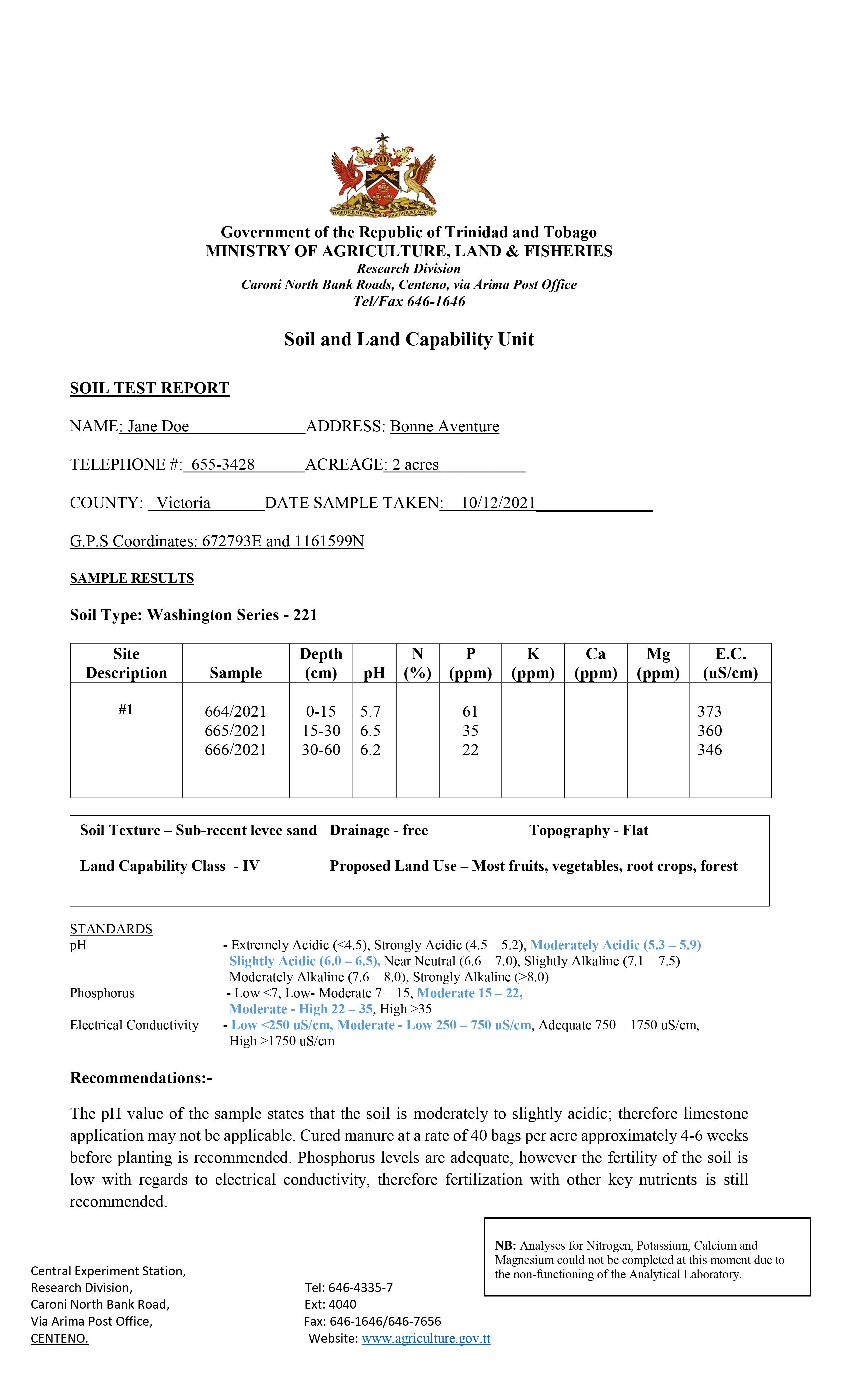
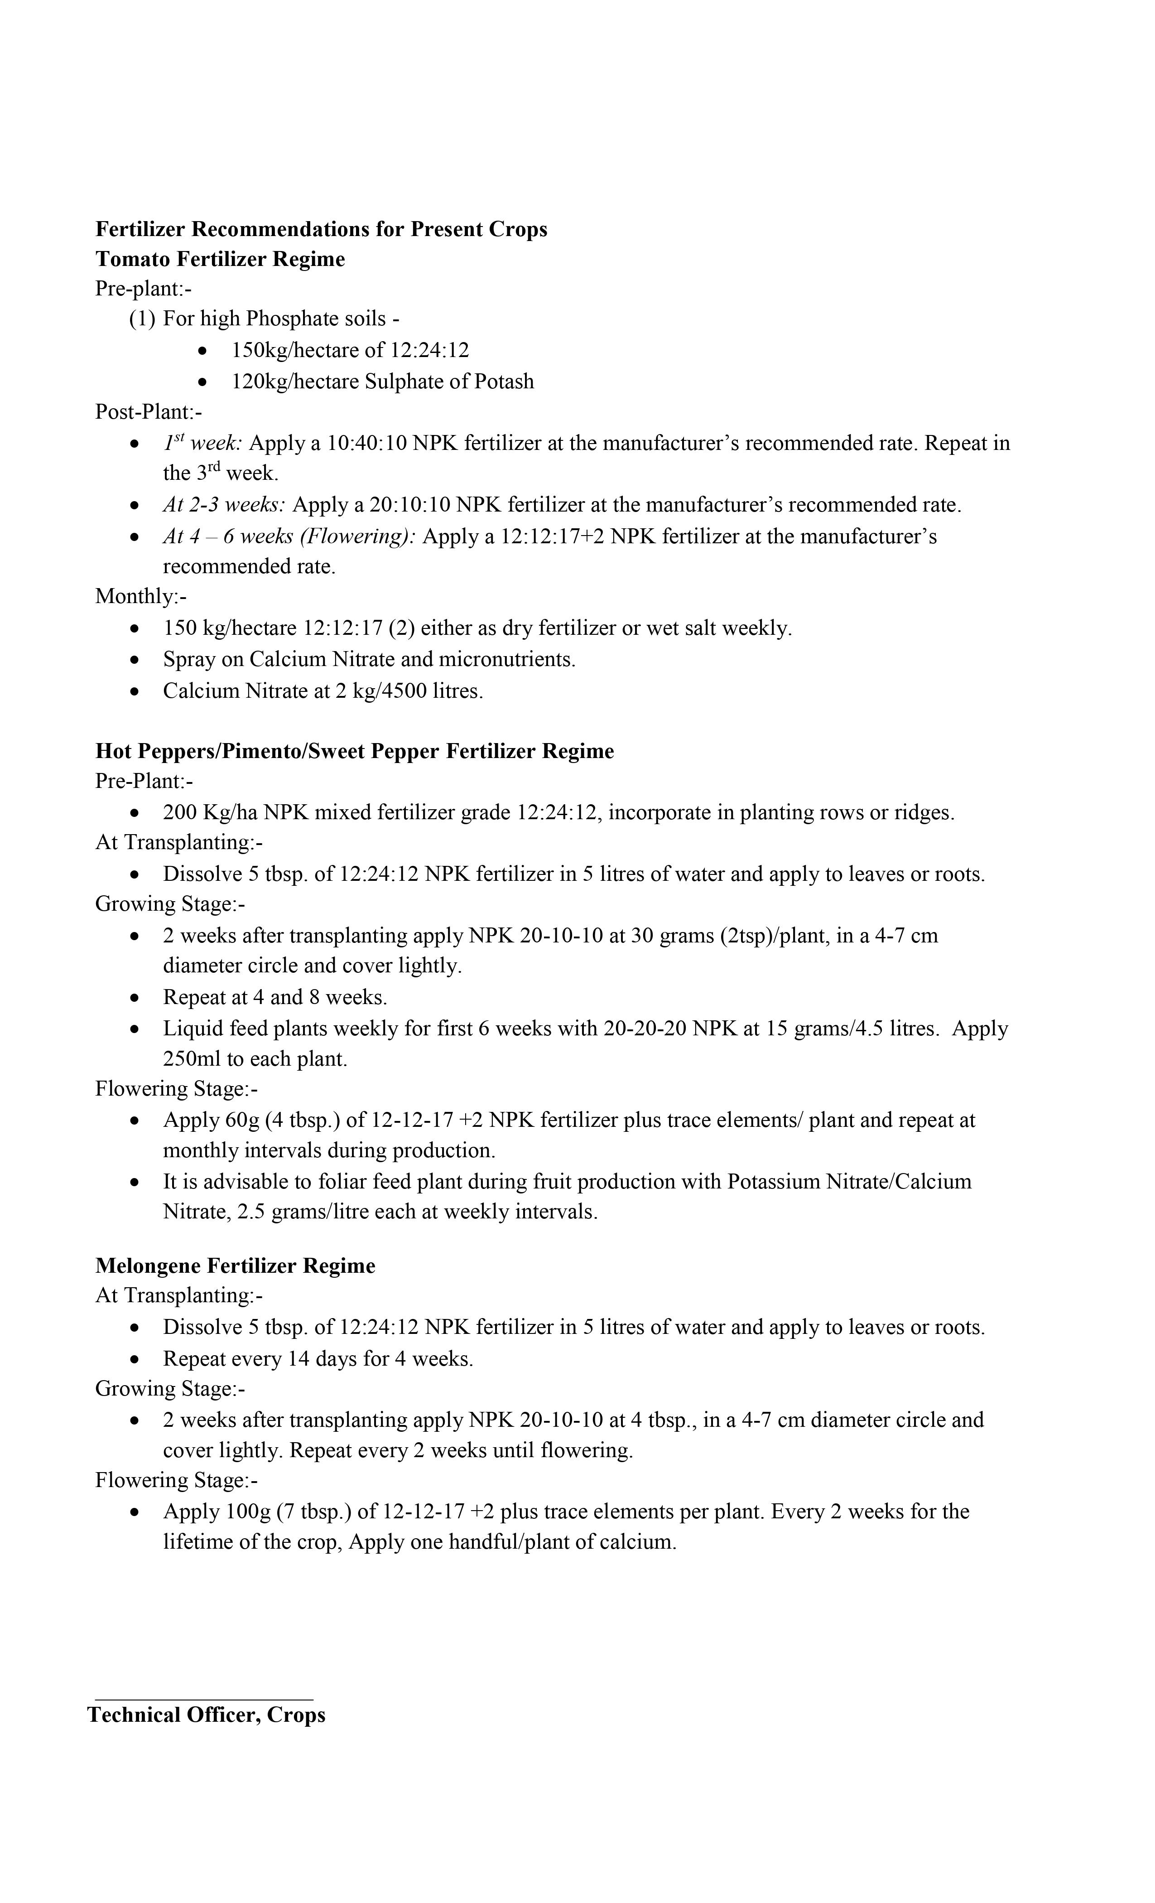
Soil Test Reports

Slide 20
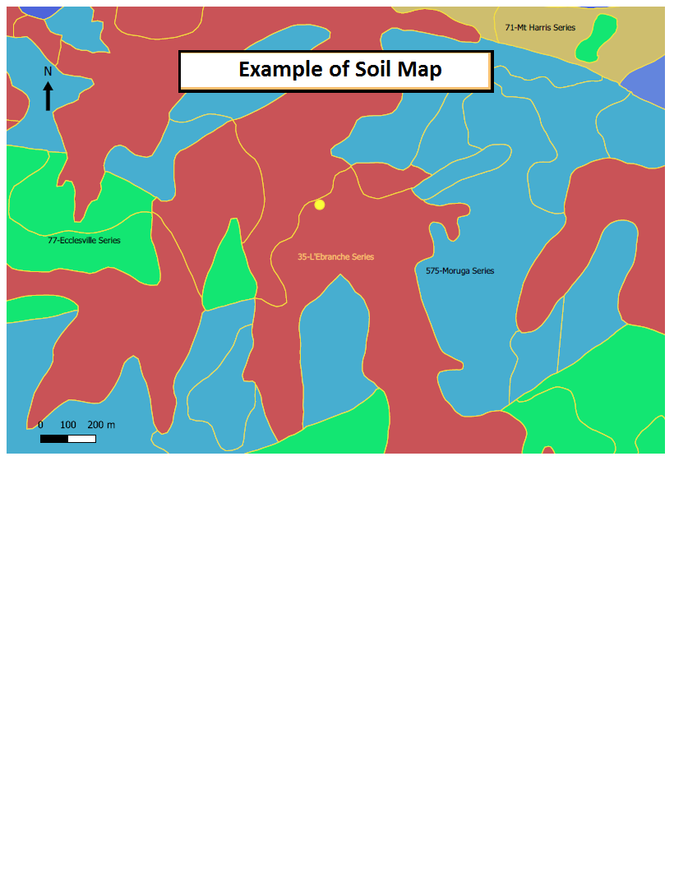

Slide 21

Thank You
For more information:
gabrielle.de.souza.13@gmail.com

