Slide 1
MINISTRY OF AGRICULTURE, LAND, AND FISHERIES. RESEARCH DIVISION
OVERVIEW:
The Soil and land Capability Unit is responsible for the servicing of Farmers and Farmers’ Associations through soil testing, analysis and training.
MINISTRY OF AGRICULTURE, LAND AND FISHERIES
Research Division
Central Experiment Station,
Caroni North Bank Road,
Mausica Road,
Mausica
SOIL AND LAND CAPABILITY UNIT SERVICES
Tel: 646-4335-7
Fax: 646-1646/646-7656
www.agriculture.gov.tt
Soil and Land Capability Unit, Centeno

Slide 2
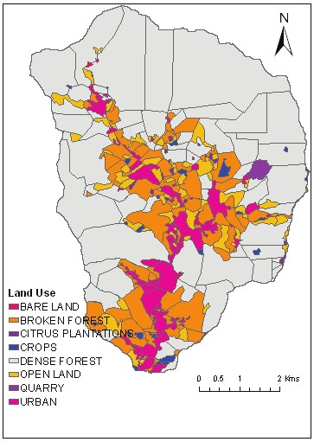
National Soil Testing Programme:
Soil Testing Services:
Soil and Land Capability Reports:
Soil Testing Services that are offered by the Soil and Land Capability Unit include:
Established in 1997 by the Government of Trinidad and Tobago
Provision of Soil Testing Services of Farmers, Researchers and Farmer Organizations
Testing of 600 Farms – Approximately 3000-3500 samples
Based on the results and cropping programme farmers are advised on soil amelioration and fertilization programmes in order to improve crop production
Soil Testing is done throughout Trinidad and Tobago by a dedicated team of officers and assistants
Soil and Land Capability Maps and Reports are provided for the following:
Soil pH
Soil pH is the measure of the acidity and alkalinity in soils. The optimal pH range for most plants is between 5.5 and 7.0
Farmers
Large holdings are mapped to show different soil types and land capability classification, in order to show what suitable crop(s) can be grown on the various soil types available on the holding.
Town and Country Planning Division
Request for change of land use by applicants need to be assessed by the Department for Approval.
Agricultural Development Bank (ADB)
They are needed to procure loans for farmers by the ADB. The Department is routinely required to assist by providing soil and land capability reports as to the suitability for the proposed farming agency.
Land Settlement Agency
Routinely maps are prepared for this agency so that informed decisions can be made within Agricultural Zones.
Electrical Conductivity
Electrical Conductivity readings gives a good indication of the amount of nutrients available for your crops to absorb from the soil as well as the existence of saline conditions which can affect plant growth
Soil Nutrients
Nitrogen (N)
Phosphorous (P)
Potassium (K)
Calcium (Ca)

